Slide 1
KnoWhere
Automatically Profile your Commute using Smart Phone Sensor Data

Slide 2
Commutes are Bad for you!
Higher Blood Sugar
Higher Cholesterol
Higher Depression Risk
Higher Anxiety
High Blood Pressure
Back Aches
Source: http://time.com/9912/10-things-your-commute-does-to-your-body/

Slide 3

_{Where do I go?}
What do I do?

Slide 4
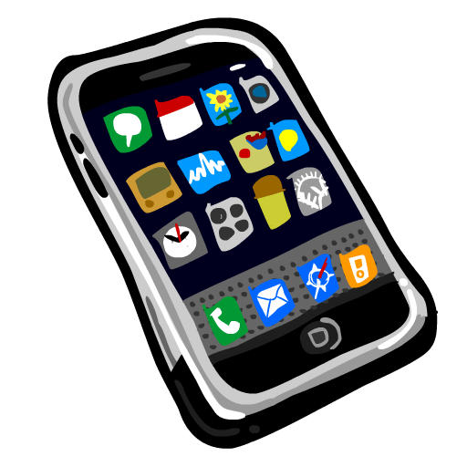



Adding Data is a Drag

Slide 5
The Front End

Slide 6
The Database

Slide 7

Data Collection from Smart Phones
Gathered for iPhone
Sensor Kinetics Pro for Android
Both apps had significant disadvantages
Inconsistent sensor readings, e.g., 10 Hz really meant 0.2 Hz
Some sensors had significantly more values than others
Some sensors only updated after a large change

Slide 8
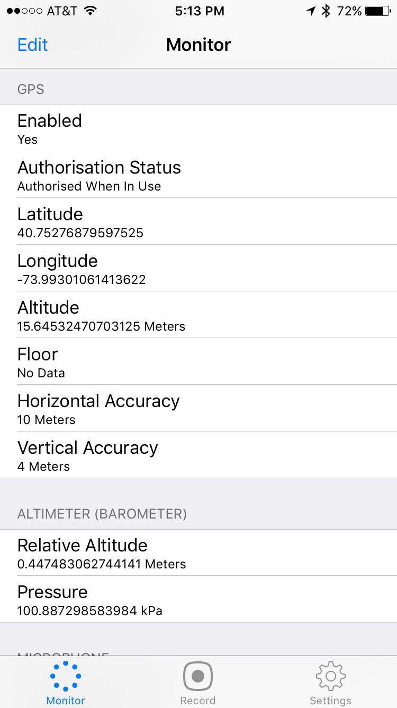
Data Collection from Smart Phones
Gathered
GPS Data
Lat/Long
Altimeter
Accelerometer
Magnetometer
Gyrometer
Attitude
Proximity
Barometer
Clustering
Movement Classification

Slide 9
Clustering
Agglomerative
Must specify number of clusters, affinity, linkage
Number of cluster set to two in our study, Ward Linkage, and Euclidian Distance
Other values performed poorly
DBSCAN
Only need to specify neighborhood size
Forms clusters
Requires more data

Slide 10
Sensor Data - Acceleration

Slide 11
Sensor Data – Altimeter

Slide 12
Sensor Data – Accelerometer

Slide 13
Machine Learning: Predicting Activities During a Commute

Slide 14
Feature Selection: GPS free tracking
Many subways and trains run underground so we use only non-GPS sensor data to for activity tracking

Slide 15
Feature Selection: GPS free tracking
Mean, Std, Max

Slide 16
Into the Woods
Modeling
Gradient Boosting Machine
Neural Network using Keras
Support Vector Machine
Random Forest
Academic work supports random forests

Slide 17
Into the Woods: Random Forest Classification SK-OPT

Slide 18
Into the Woods: Random Forest Classification SK-OPT

Slide 19
Quality of the Classifier

Slide 20
Demonstration!

Slide 21
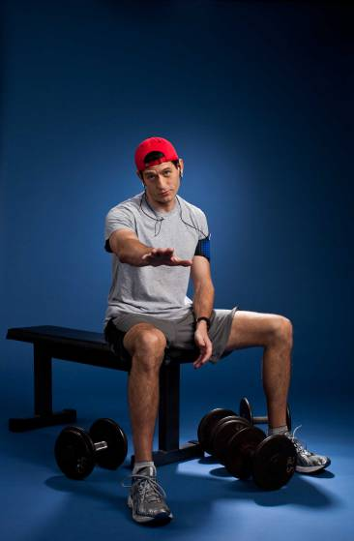
Future Development
Activity Tracking
Commute Suggestions

Slide 22
and of course…

Slide 23
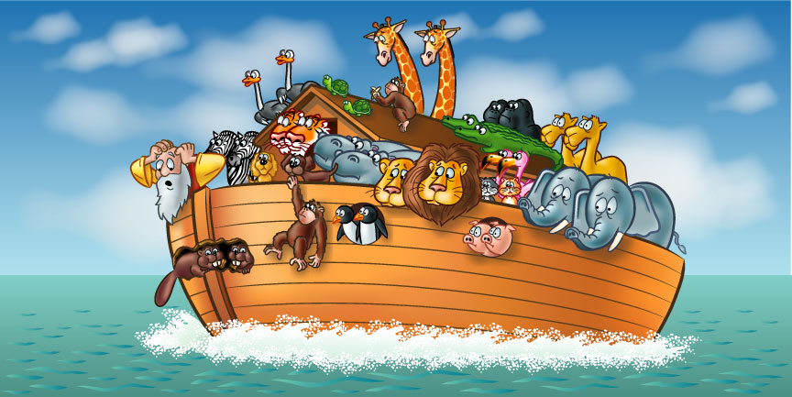
…more animals!

Slide 24
Thank You!

